Slide 1
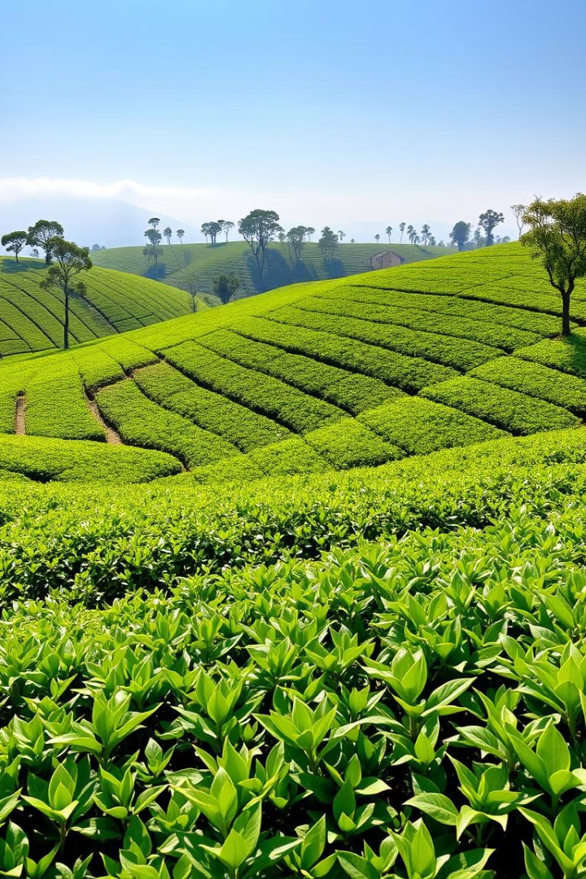
Glimpses of India – Part III: Tea from Assam
Welcome to "Glimpses of India – Part III: Tea from Assam," a captivating journey into the heart of India's renowned tea country. Authored by Arup Kumar Datta, this presentation explores the rich history, cultural significance, and fascinating process behind one of the world's most beloved beverages. Join us as we uncover the secrets of Assam's sprawling tea estates and celebrate the timeless appeal of a perfect cup of tea.

Slide 2

About the Author
A Celebrated Indian Writer
Arup Kumar Datta is a celebrated Indian writer and journalist, recognized for his significant literary contributions.
Literary Style and Focus
His vivid nature descriptions and engaging storytelling skillfully bring the diverse culture of Northeast India to life.
Themes and Accolades
His writings deeply explore the ecology, history, and traditions of the region. For his literary excellence, he was honored with the prestigious Padma Shri.

Slide 3



Introduction to 'Tea from Assam'
An Informative Travelogue
A Train Journey of Friendship
Exploring Tea Gardens and Facts
'Tea from Assam' is a descriptive and engaging travelogue that takes readers on an enlightening journey through the beautiful state of Assam, highlighting its rich tea culture.
The narrative revolves around a memorable train adventure shared by two friends, Rajvir and Pranjol, as they travel to Pranjol's home in Assam during their summer vacation.
The story vividly showcases the sprawling tea gardens of Assam and unveils a treasure trove of fascinating facts and historical insights about the origin and global consumption of tea.
This segment sets the stage for a delightful exploration, blending personal experience with educational content about one of India's most iconic exports.

Slide 4
Meet the Main Characters
Rajvir
Pranjol
Mr. Barua
Rajvir is depicted as an intelligent and inquisitive young boy, deeply enthusiastic about learning new things. He has done extensive research on tea, demonstrating his well-read nature and thirst for knowledge.
Pranjol is Rajvir's close friend and a native of Assam, providing a local perspective to their journey. His father manages a large tea estate, giving Pranjol an inherent understanding of the tea industry.
Mr. Barua is Pranjol's father and the experienced manager of a tea estate in Assam. He plays a crucial role in welcoming the boys and sharing insights into the practical aspects of tea cultivation.
These characters form the core of the narrative, each contributing uniquely to the educational and experiential aspects of the travelogue.

Slide 5




The Journey Begins: Fascinating Tea Facts
Traveling to Assam
Global Tea Consumption
Origin in China
Early European Use
Rajvir and Pranjol embark on a train journey to Assam, a picturesque trip taken during their summer vacation, filled with anticipation and discovery.
He explains that tea was first discovered in China, with ancient legends attributing its discovery to an emperor who preferred boiled water.
Interestingly, when tea was first introduced to Europe, it was primarily consumed for its medicinal properties rather than as a beverage for pleasure.
Rajvir eagerly shares an astounding fact: over 800 crore cups of tea are consumed globally every single day, highlighting its immense popularity worldwide.
This segment captures the excitement of the journey while weaving in intriguing historical and statistical details about tea, enriching the travel experience.

Slide 6
Arrival in Assam: A Sea of Green
Lush Green Landscape
Sprawling Tea Bushes
Tea-Pluckers at Work
As the train approaches Assam, the landscape transforms into a breathtaking expanse of lush green. The dense greenery outside the windows signifies their entry into the heart of India's tea country, offering a visual feast.
Endless rows of meticulously trimmed tea bushes stretch as far as the eye can see, resembling a perfectly manicured green carpet spread across the rolling hills. This iconic sight defines the region's agricultural beauty.
Rajvir keenly observes figures moving amidst the tea bushes. He identifies them as tea-pluckers, distinguished by their traditional aprons and the large bamboo baskets strapped to their backs, diligently picking tea leaves.
This card vividly paints the scene of Assam's iconic tea gardens, immersing the reader in the sensory experience of arriving in this unique landscape.

Slide 7



Experiencing the Tea Garden Firsthand
Warm Welcome
Rajvir's Curiosity
Upon their arrival at the railway station, Mr. Barua, Pranjol's father, extends a warm and hospitable welcome to the two friends, marking the beginning of their immersive experience.
Rajvir, ever eager to learn, expresses his deep interest in delving further into the intricacies of the tea industry, from cultivation to processing, eager to gain firsthand knowledge.
The Second Flush
Mr. Barua informs them about the "second flush" or "monsoon flush," explaining that this period, from May to July, yields the best quality tea leaves with superior flavour and aroma.
This segment highlights the practical side of tea production and Rajvir's eagerness to learn, bringing the reader closer to the daily life within a tea estate.

Slide 8




Key Themes & Underlying Message
Exploration and Curiosity
Natural Beauty of Assam
Cultural Heritage
Tea is presented not just as a beverage, but as an integral part of India's identity and economic backbone. The narrative celebrates its historical significance and cultural integration.
Rajvir's character embodies the essence of curiosity and the importance of continuous learning. His enthusiasm encourages readers to observe and seek knowledge about the world around them.
The story richly describes Assam's picturesque landscapes, particularly its sprawling tea gardens, highlighting the region's serene natural beauty and vibrant tea cultivation culture.
These themes collectively convey the story's deeper meaning, promoting an appreciation for learning, nature, and cultural heritage.

Slide 9

Conclusion: A Blend of Education and Experience
Appreciation for Regional Cultures
Seamless Blend of Travel & Education
Ultimately, the story encourages readers to develop a deeper appreciation for diverse regional cultures and traditions that contribute to India's rich tapestry.
Insight into Tea's Journey
The travelogue provides a comprehensive overview of tea, from its mysterious origins and fascinating historical journey to its significant role in contemporary society.
'Tea from Assam' masterfully combines the joy of a travel experience with educational insights, making learning about history and geography an enjoyable adventure.
This presentation concludes by reinforcing the story's dual purpose: to educate and to inspire an appreciation for India's diverse heritage, all through the simple yet profound lens of a cup of tea.

